Slide 1
GS1 HK Smart Retail Case Sharing -
A New Way to Connect Consumers and Gain Market Insight
Isabel Tsui
isabeltsui@gs1hk.org, GS1 HK
Oct 25th 2019

Slide 2

GS1 Smart Retail Solution
Case Sharing – A New Way to Engage Consumers and Gain Market Insight

Slide 3
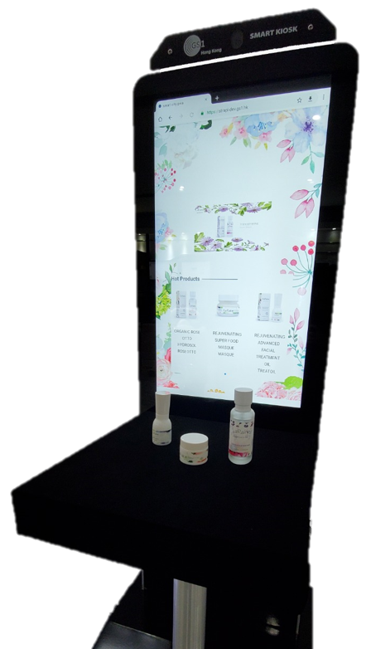
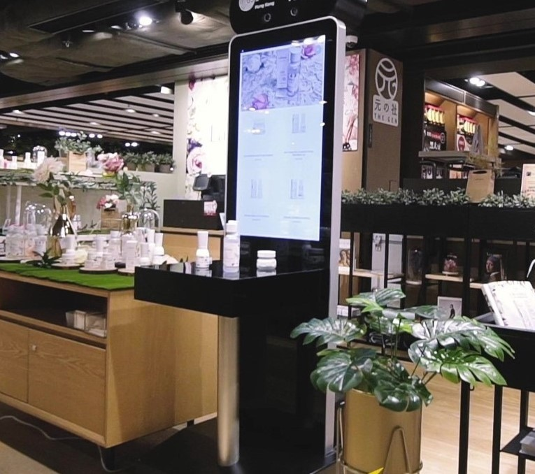
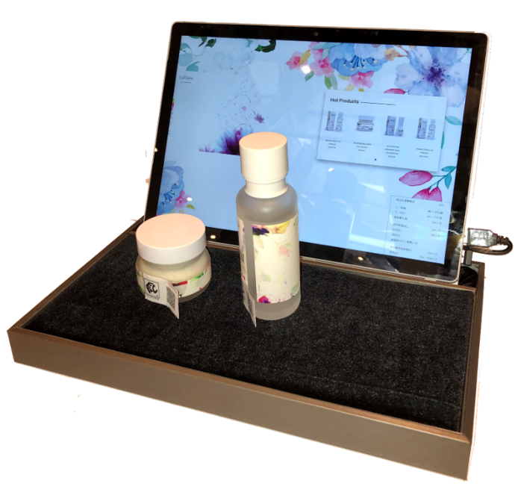
A New Sales and Marketing Way to Connect Consumers and Gain Insights
CONNECT
PRODUCT INTRODUCTION
ENGAGE
SHOPPERS
COMMERCE
  RECOMMENDATIONS & SALES
GAIN INSIGHT
SHOPPER PROFILE

Slide 4
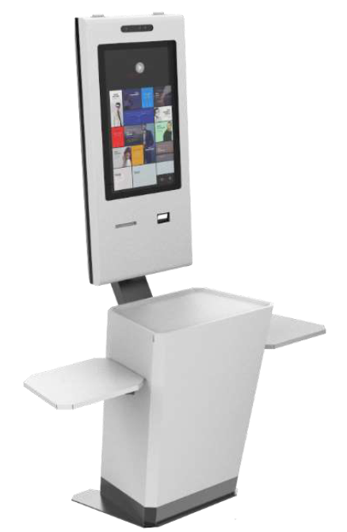
Different Outlook of Smart Kiosk

Slide 5
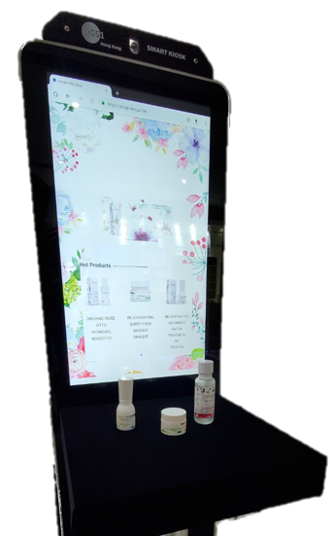
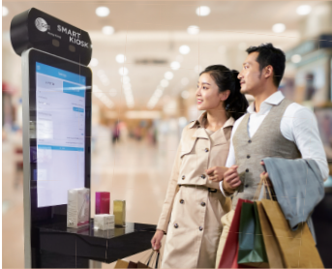


Smart Kiosk/Tray Packed with Advanced IoT Technologies
Real-Time Video Analytics
Camera to collect customer gender, age & emotion
Counts traffic to the kiosk and staying duration
On-the-spot identify return shoppers
Touch Screen Display
Displays product details and promotion video
Allows customer to choose more in-depth product information
Captures customer browsing trends
RFID Antenna
Detects product being picked up and duration
Auto-Triggers on-screen product introduction

Slide 6
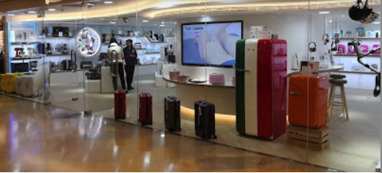
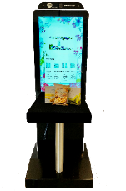

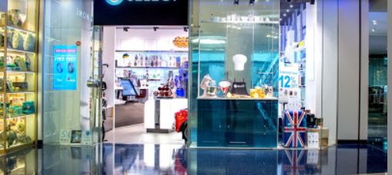
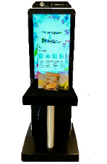
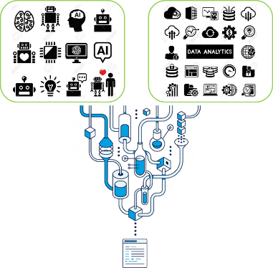
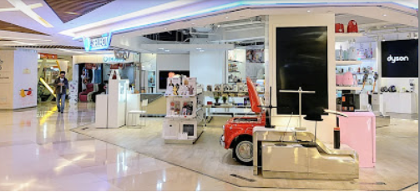
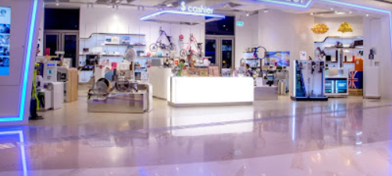
Network of Smart Touch Points
Support multiple GS1 Smart Kiosks and GS1 Smart Trays
Real-time identifying repeated shoppers at same or different store locations
Knowing browsing history to promote personalized products and offers
Gather more precise shopping trends and gain more in-depth insights
Combine data from different locations to derive more accurate market trends
Understand more shopper visit behavior
Facilitate Brand Owner / Retailer Inventory Management
Stock popular items according to gathered insights
Put right promotional items and offers
Admiralty
Kowloon Tong
Shatin
Tseung Kwan O

Slide 7



At Heart – Advanced AI & Data Analytics for Sales & Marketing
In-Deep Understanding Shopper Profile
Know Your Shopper: Gender, Age, Emotion,…
Know What Shopper Likes: Product browsed and duration
Motivate Buying Decision
Present personalized product information and promotional offers
Immediate online purchase with discount offers
Enhance Consumer Purchase Experience
New revenue stream with Cashless Payment support
Fast lane counter on promotional items

Slide 8
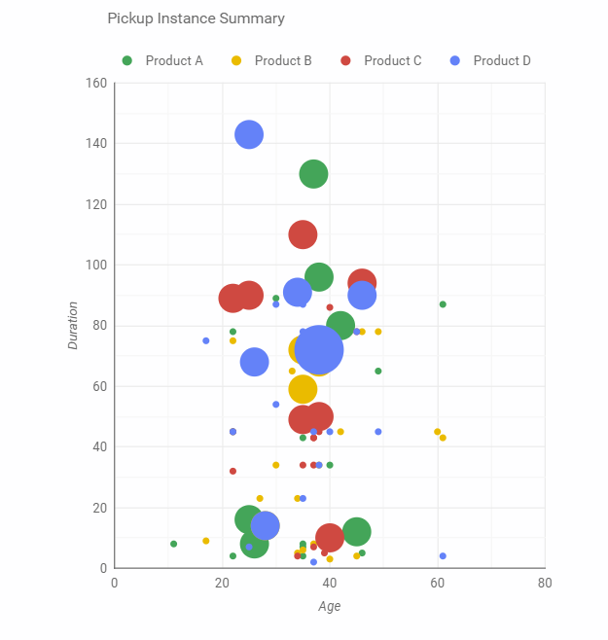
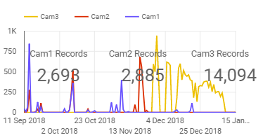
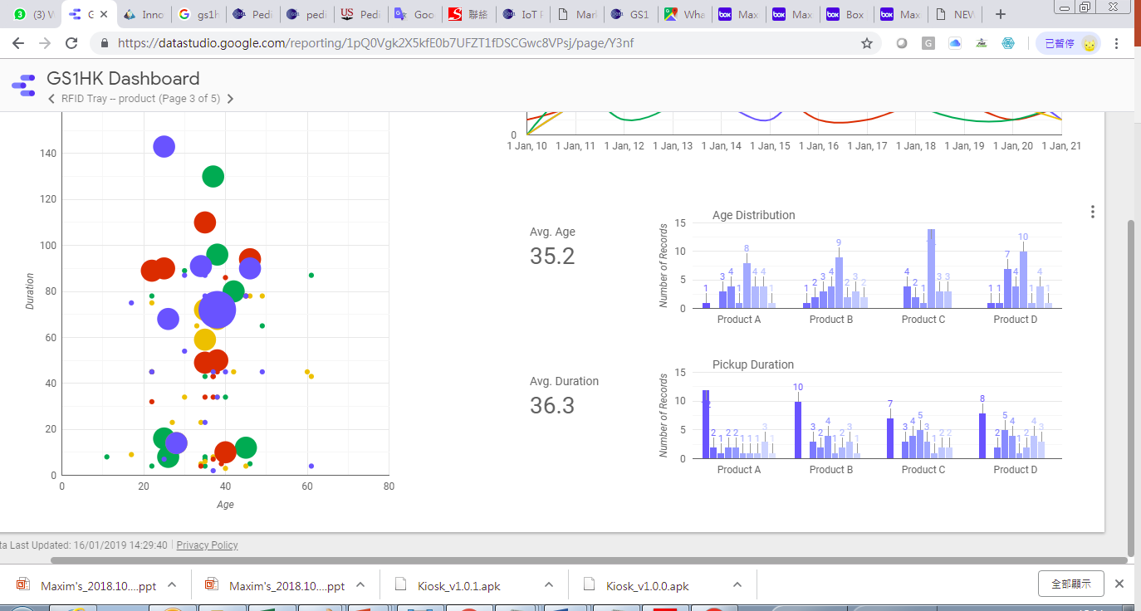
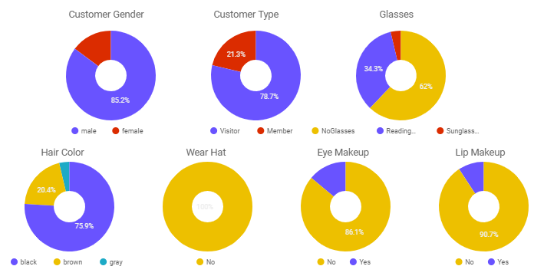
In-Return with Deep Insights on Shopper Activities
Comprehensive insights on consumer and product analytics
Special coupon or direct purchase discount can be offered according to the number of times the same customer interested to the same product

Slide 9
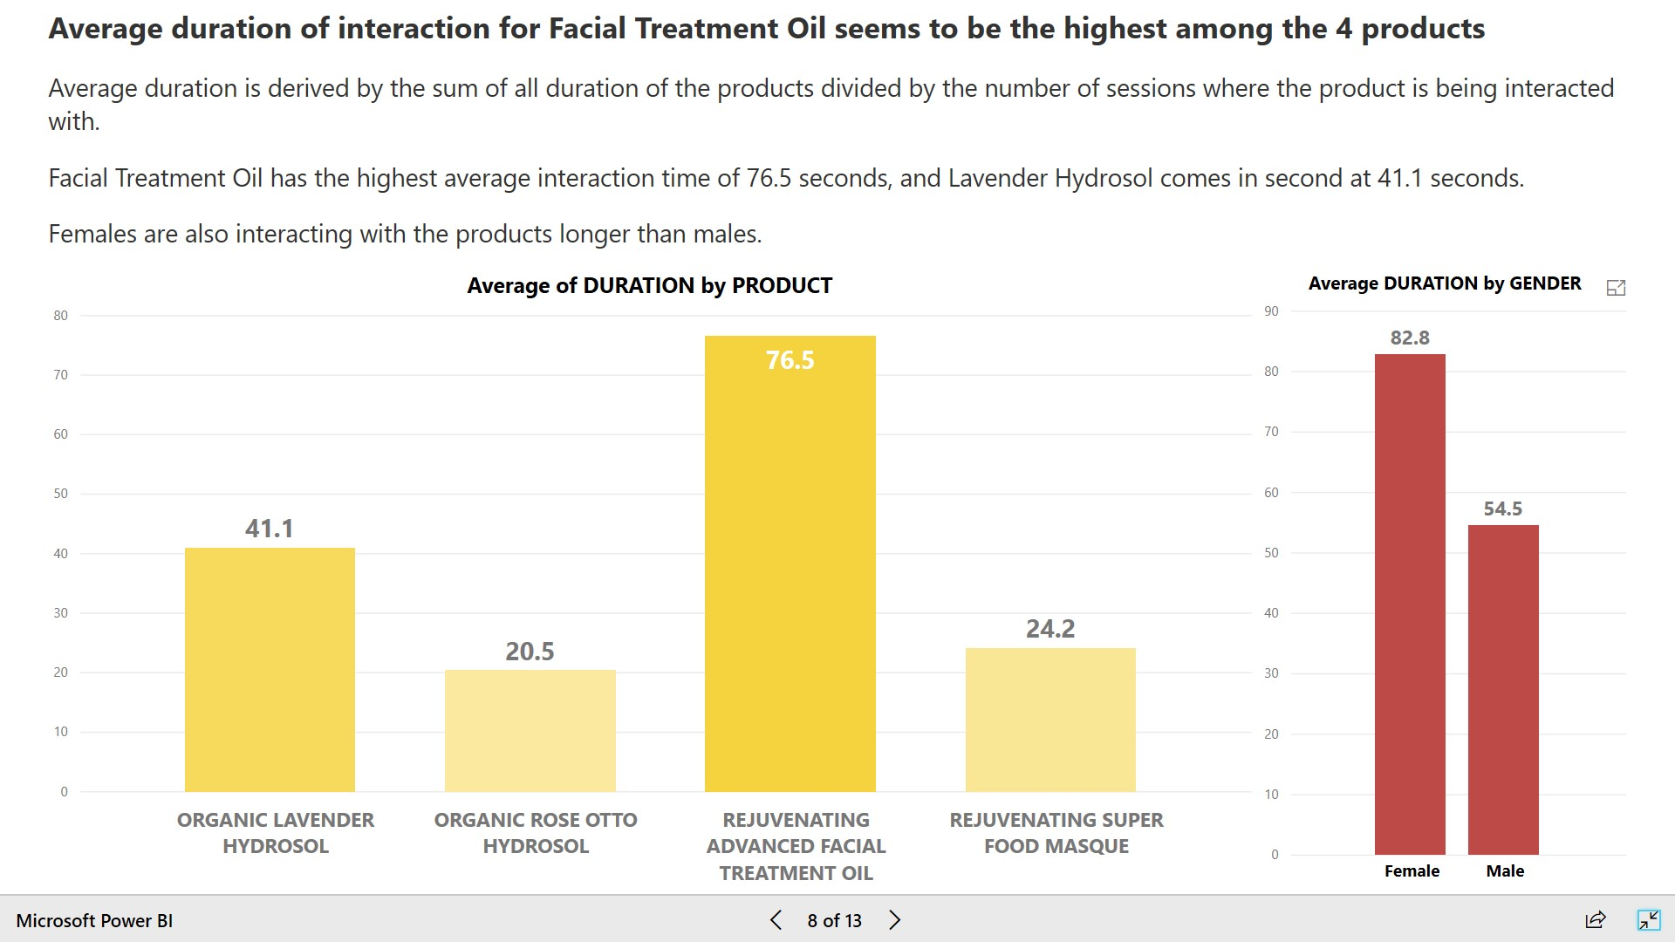

Slide 10
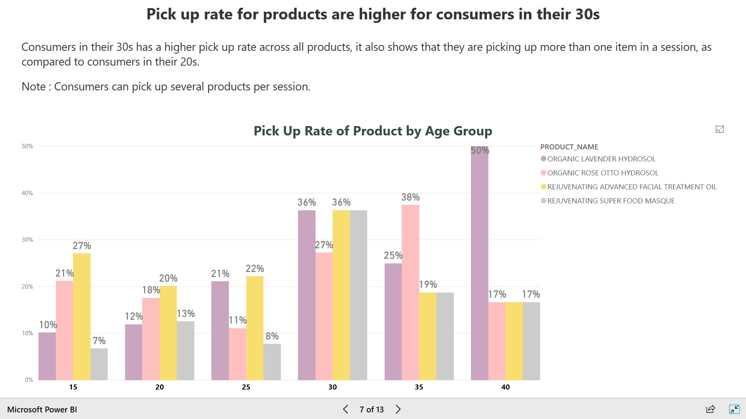

Slide 11
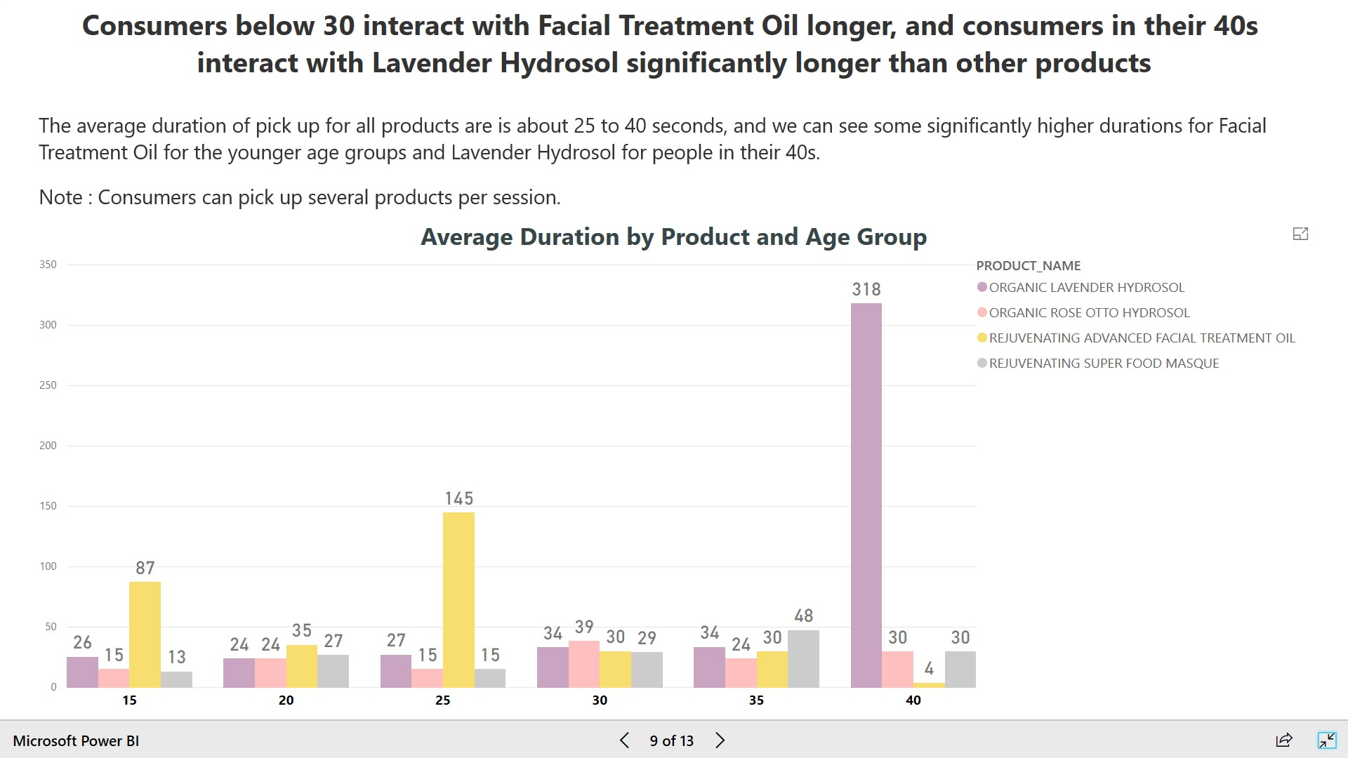

Slide 12
What Are the Must Analytics Reports for Product Marketer
Shopper profile analysis such as age group, gender, visit duration, etc.
Product preference by age group, gender, browsed duration, etc.
Product preference by new or repeated shoppers
Product browsed by age, gender, etc.
Responsiveness to marketing offers by age, gender
Shopper traffic heat map

Slide 13

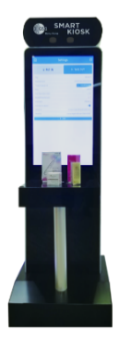
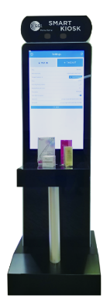
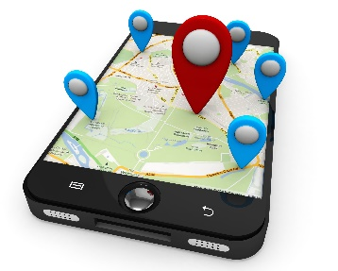


Other Questions of Retailers - Strategic Marketing Planning
Support
Mass Locations
User Define Subscription Period
Unlimited Kiosk Expansion

Slide 14
Any Questions?

